Slide 1
Chaitanya Mangla IOSC ML Project
Pima Indians Diabetes Classification
Use Classification to predict the binary outcome (presence or absence) of diabetes based on patient health records

Slide 2
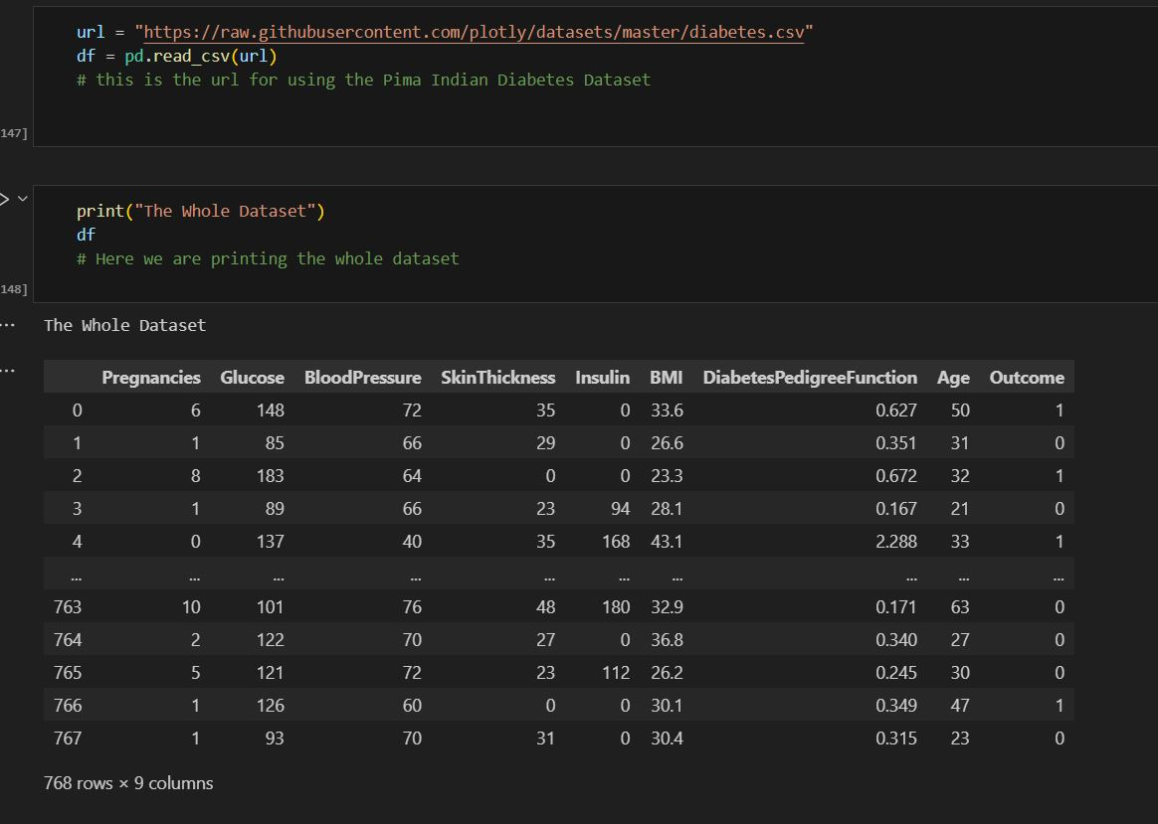
Importing the Data Set
The famous Pima Indians Diabetes Dataset has been use here to apply classification machine learning model and make predictions .

Slide 3
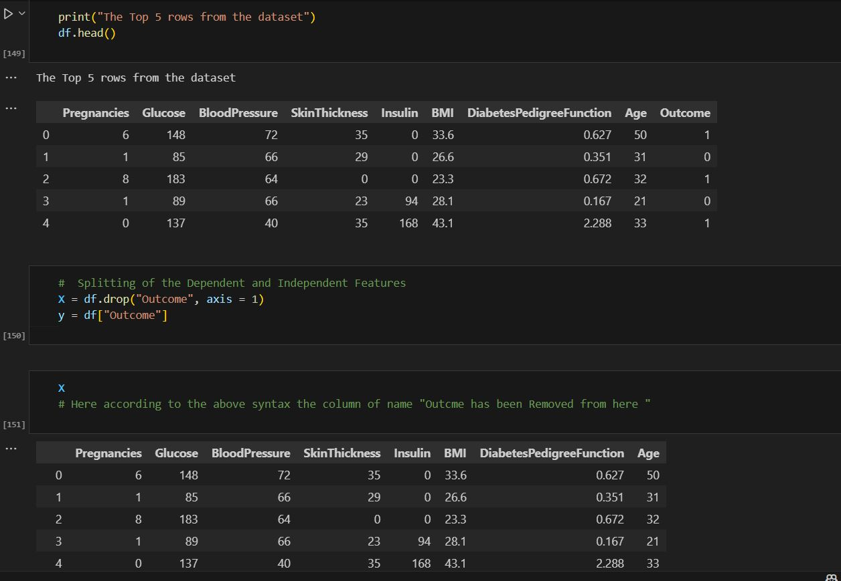
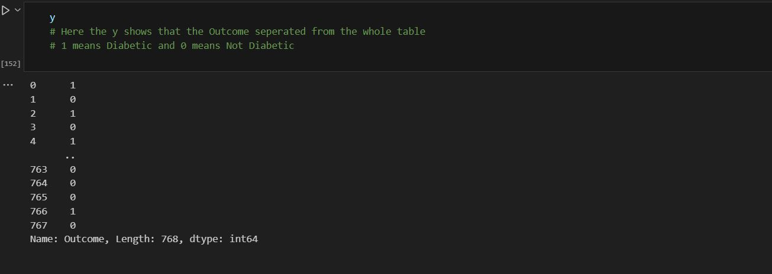
The data is taken and the head information is printed for analyzing.
The data is then made to be divided in dependent and independent features and also drop function is used to remove the outcome columns.

Slide 4
Importing Skicit Library
Here the skicit library is imported to import train test split model and also the Standard Scaler Model.
Train test split function is to train and test the model on the basis of the given dataset, based on which the predictions can be made.
Standard Scaler is basically the process of feature scaling which is a pre processing technique that converts to mean of 0 and standard Deviation of 1.

Slide 5
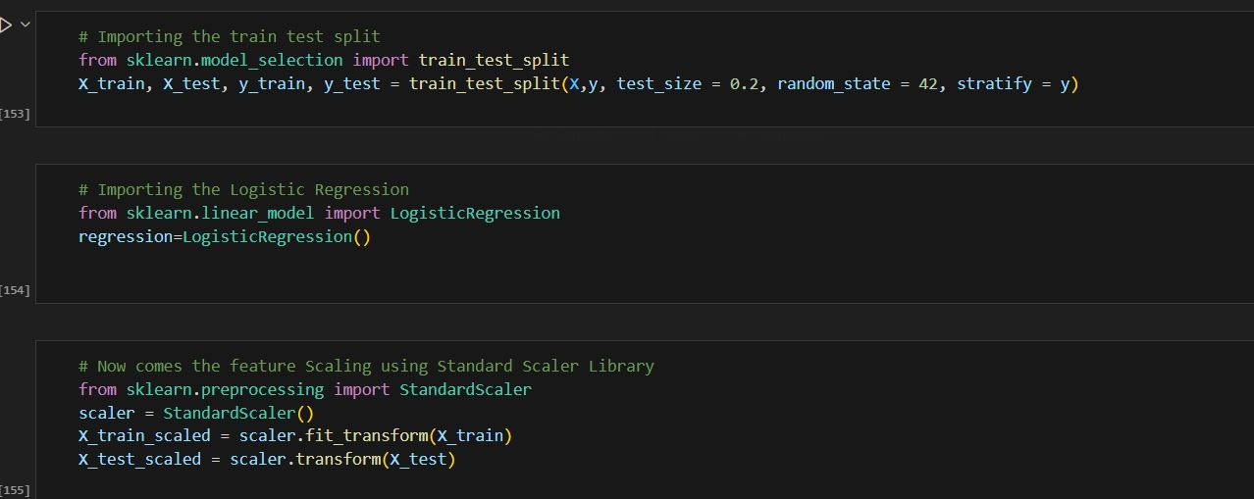
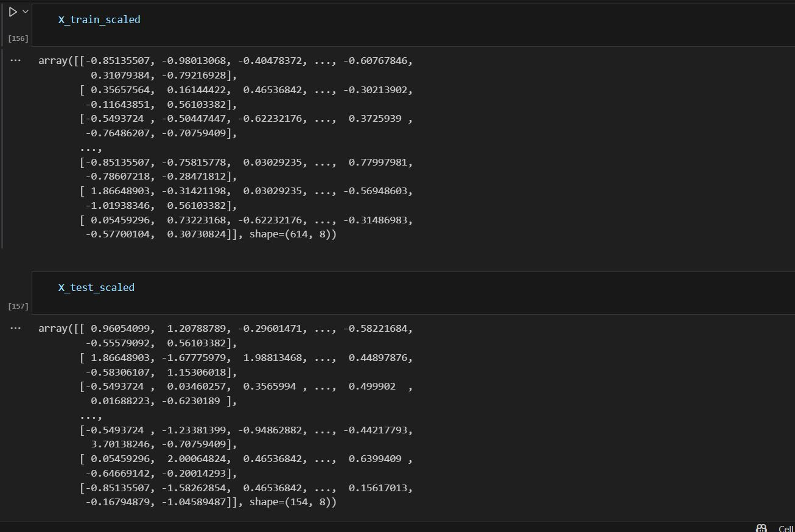
Skicit Library Photos

Slide 6
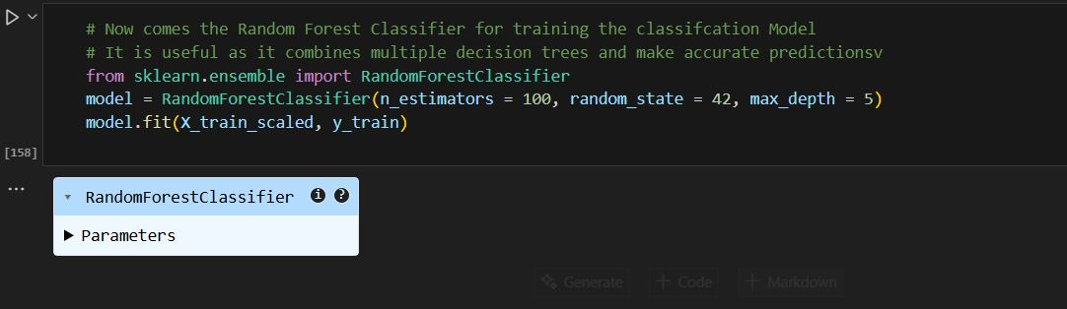
Random Forest Classification
Random Forest Classification is an ensemble type of learning that helps to create the multiple decision trees during the model training and outputs the mode of the classes predicted by random trees.
It introduces randomness to the model and increases accuracy and minimize overfitting.

Slide 7
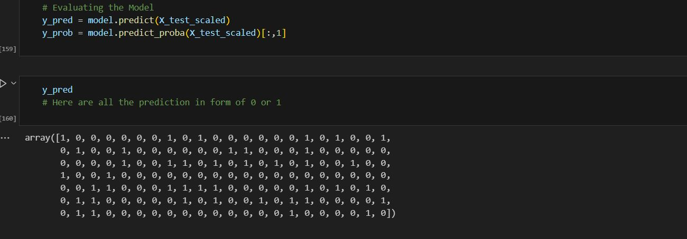
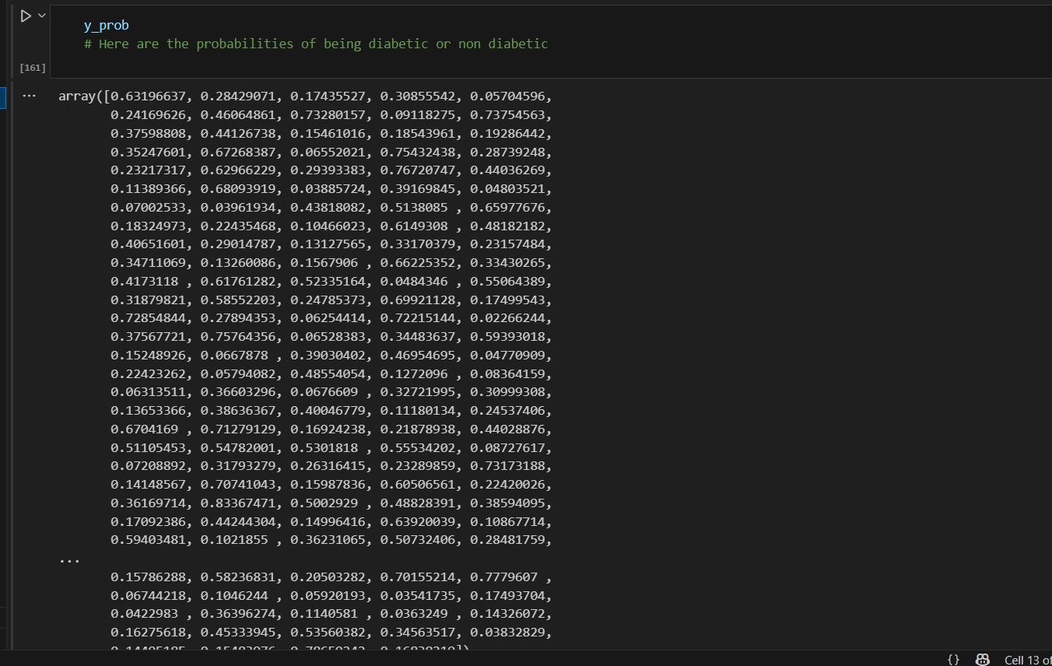
Evaluating the Model
The model is evaluated and then used to calculate to prediction of the outcomes and also the probabilities.

Slide 8
Using Skicit Metrics for Evaluation
By using the skicit library, we evaluate the accuracy score, confusion matrix, auc-roc score and classification report.
Accuracy Score : It measures the correctness of the performance of the prediction of models. More the accuracy score, more accurate.
Confusion Matrix : It is used to evaluate the performance of the classification model, comparing the predictions to actual outcomes.
AUC-ROC Score : It is a performance matrix that measures how well a model distinguishes between the two classes ranging from 0 to 1.
Classification Report : It provides a comprehensive view of the classifier model.

Slide 9
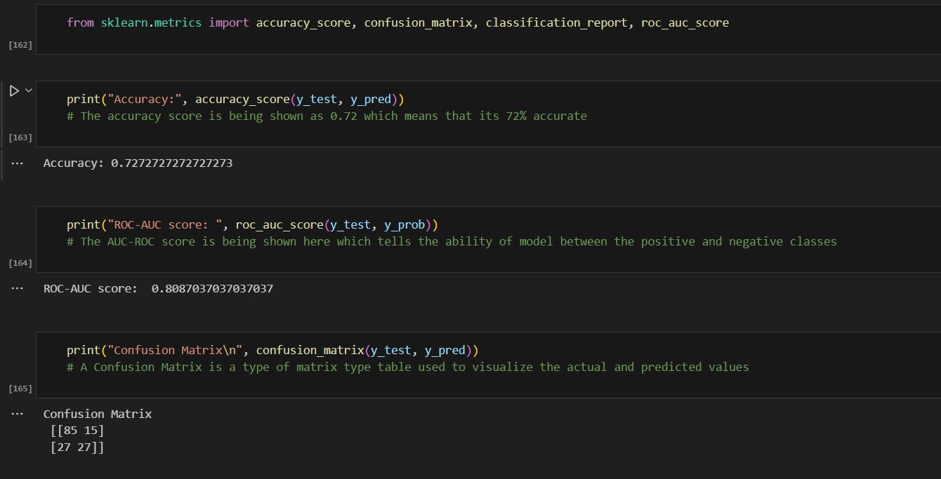
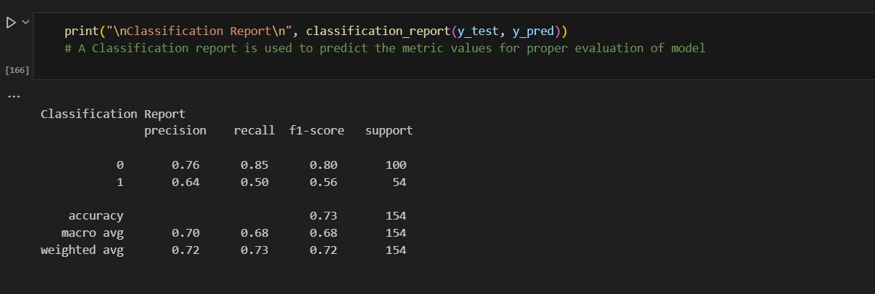
Metrics Evaluation Pictures

Slide 10
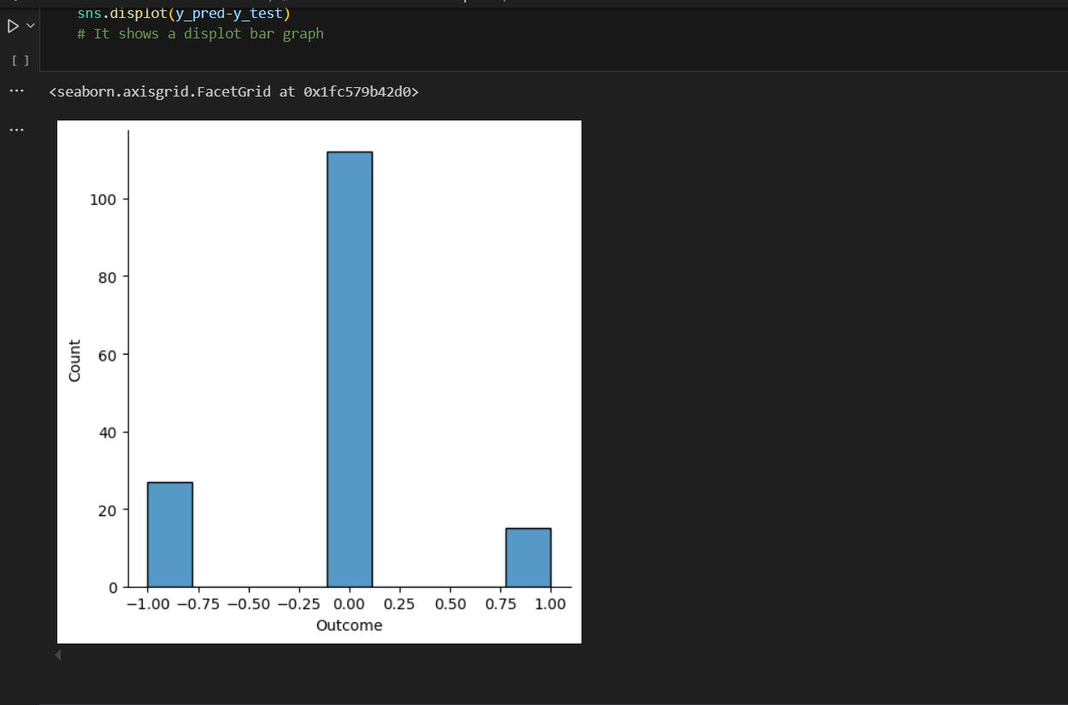
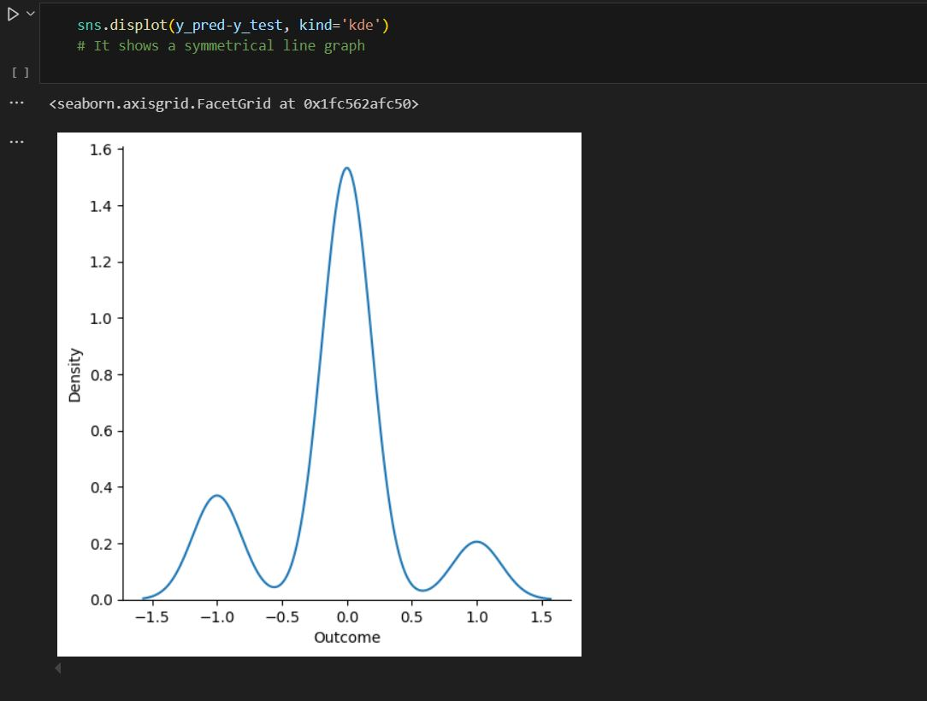
Graph Plotting

Slide 11
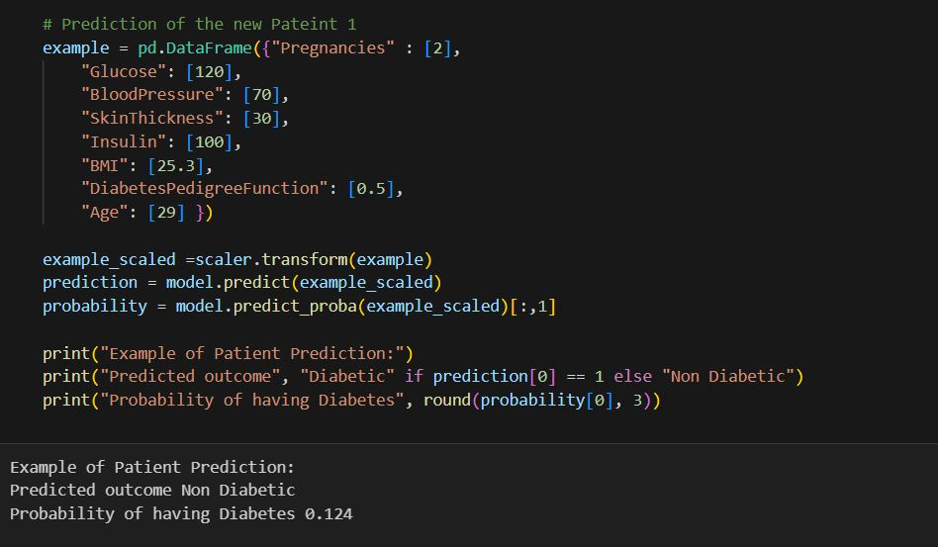
New Patient 1 Prediction

Slide 12
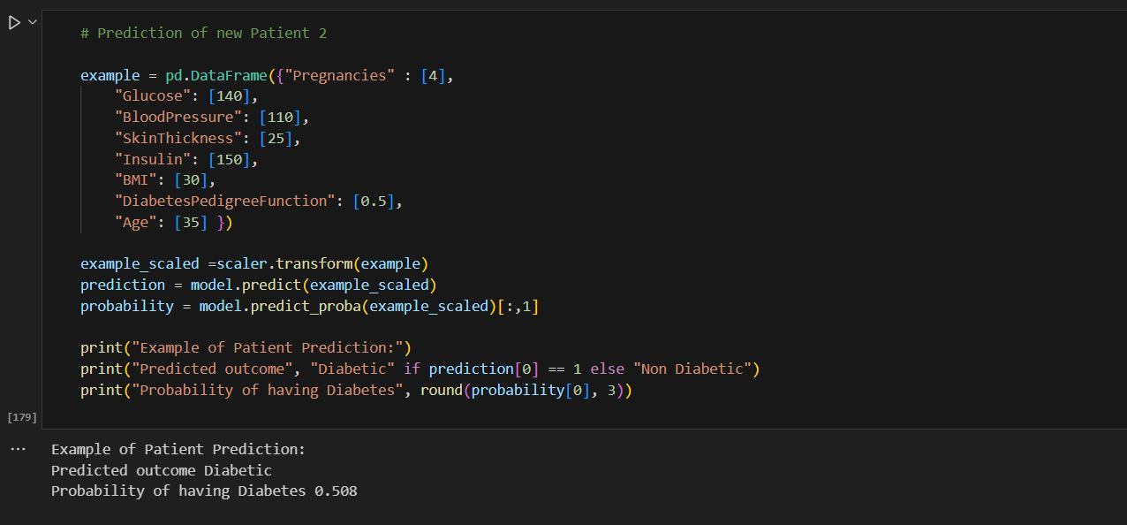
New Patient 2 Prediction

Slide 13
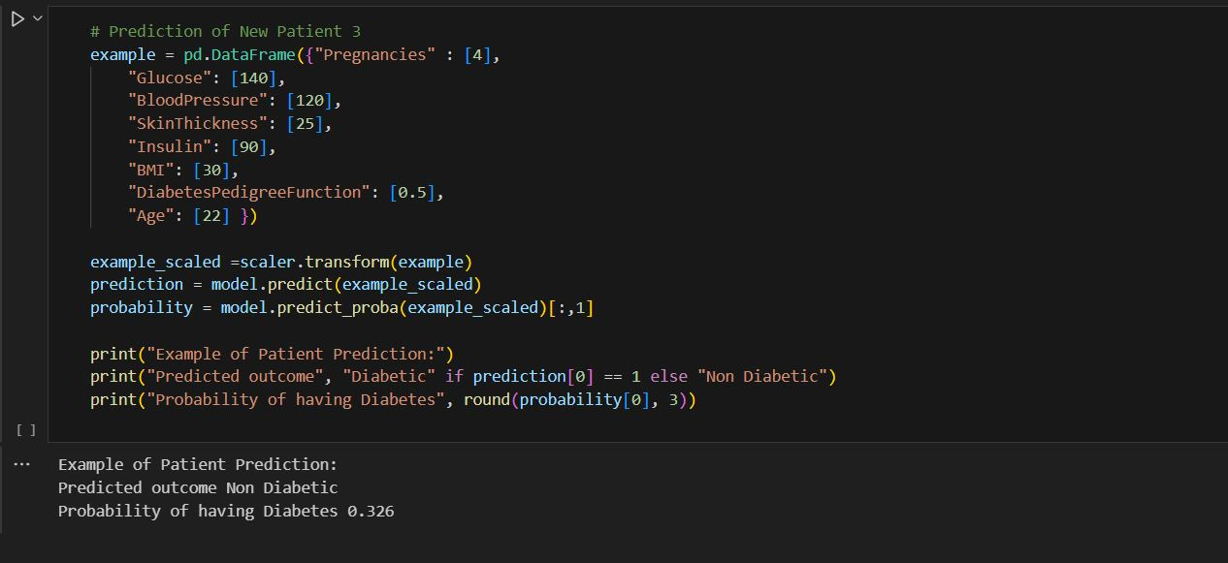
New Patient 3 Prediction

Slide 14
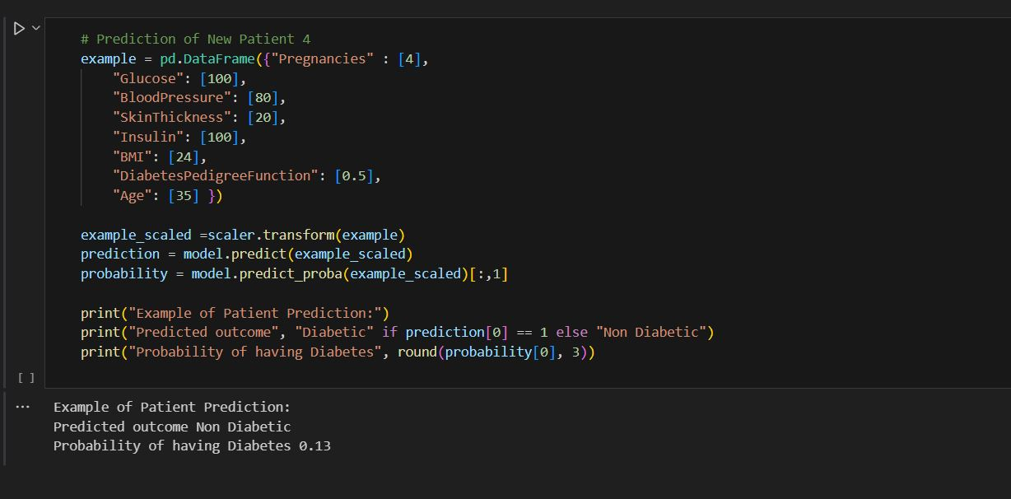
New Patient 4 Prediction

